Slide 1


Natural noise generator using CUDA
Sebastian Resendiz A01701111

Slide 2

Context
Randomness is everywhere in computing
Can be created by physical, or mathematical means
Sometimes there's need to get more controlled randomness

Slide 3
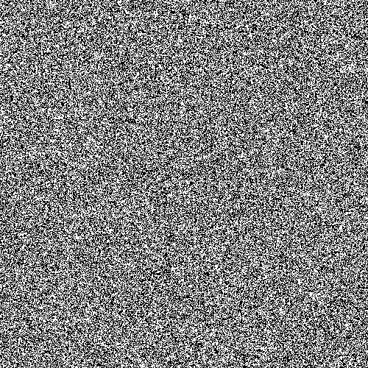
Problem
Randomness looks ugly
Its hard to get something natural looking

Slide 4

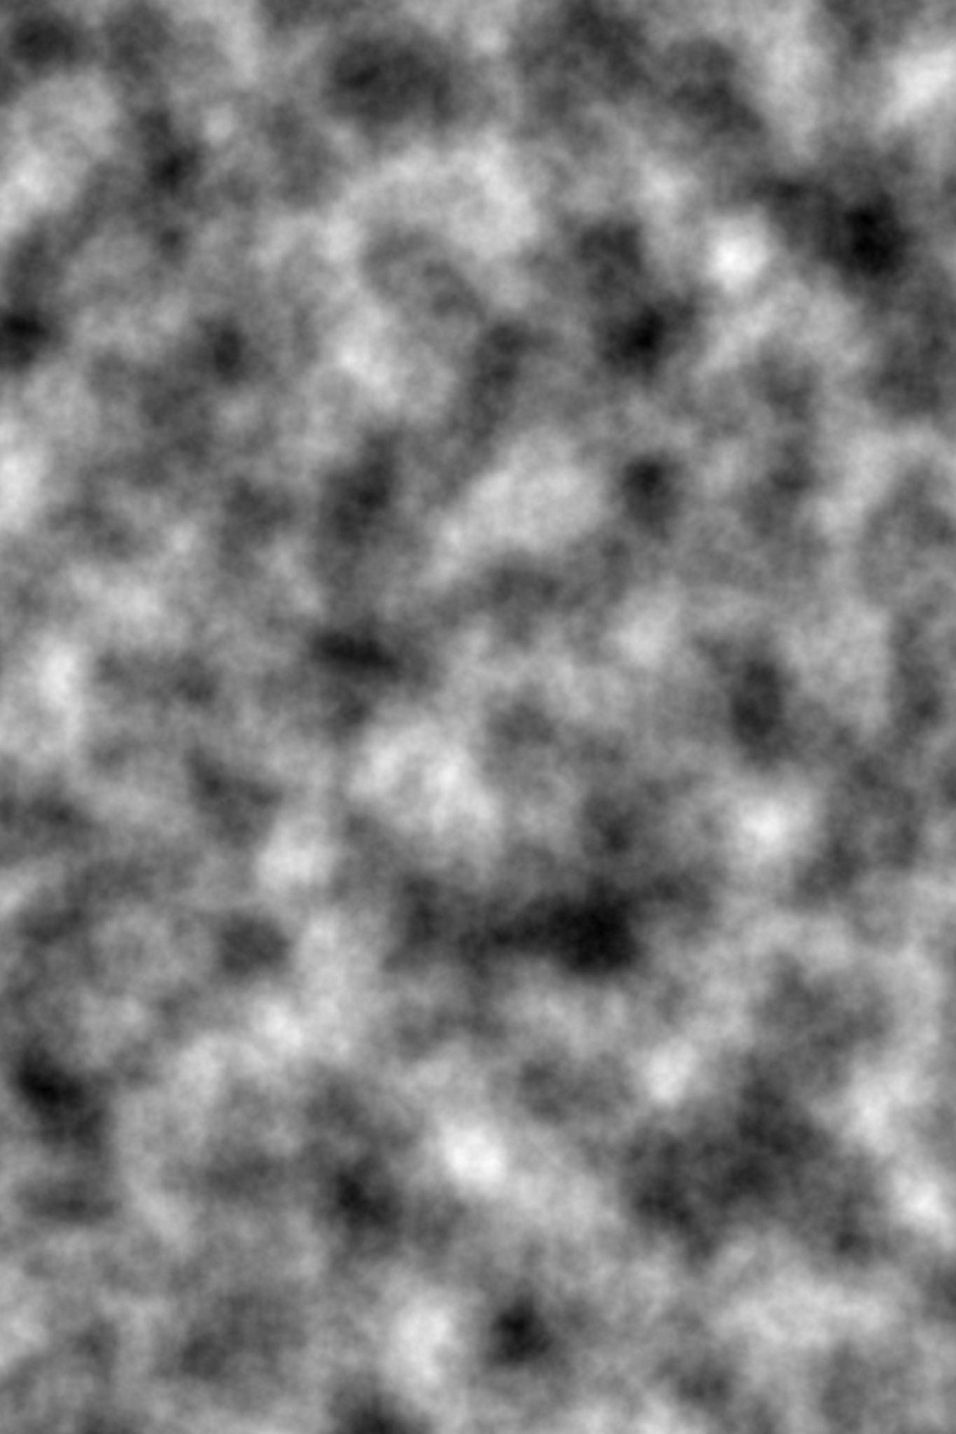
Solution
Create a more organic randomness generation
Use mathematics to compute the missing parts

Slide 5
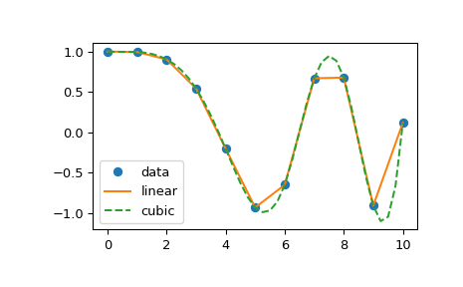
Solution
Get random or semi random numbers
Smooth the numbers
Interpolate
Repeat by octave
End!

Slide 6
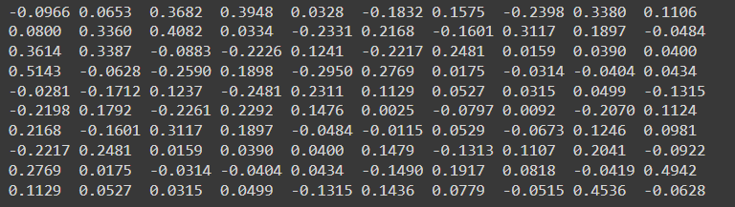
Results

Slide 7

Conclusion
It is useful to create more organic random numbers
Its very handy
Using CUDA does make it faster

Slide 8
Thanks!

